Slide 1
APRS Reference PDR
FERRER, Javier
Date: 2023/05/22

Slide 2
Function and Performance
Purpose : Provide satellite APRS Digipeating service for Amateur Radio Community.
Function 1: Digipeater APRS packets from amateur radio stations on the ground.​
Performance 1a: Transmit satellite APRS beacon to ground​
Performance 1b: Receive and retransmit APRS packets from amateur radio stations.
Performance 1c: Transfer the received data packets to desired micro controller.

Slide 3
Function and Performance
Function 2 : Store the received data.​
Performance 2a: Store the data to satellite’s specified memory location.​
Function 3 : Data transfer to the COM MCU​.
Performance 3a: Transfer stored data to COM MCU for download via UHF 4800 bps to ground stations.

Slide 4
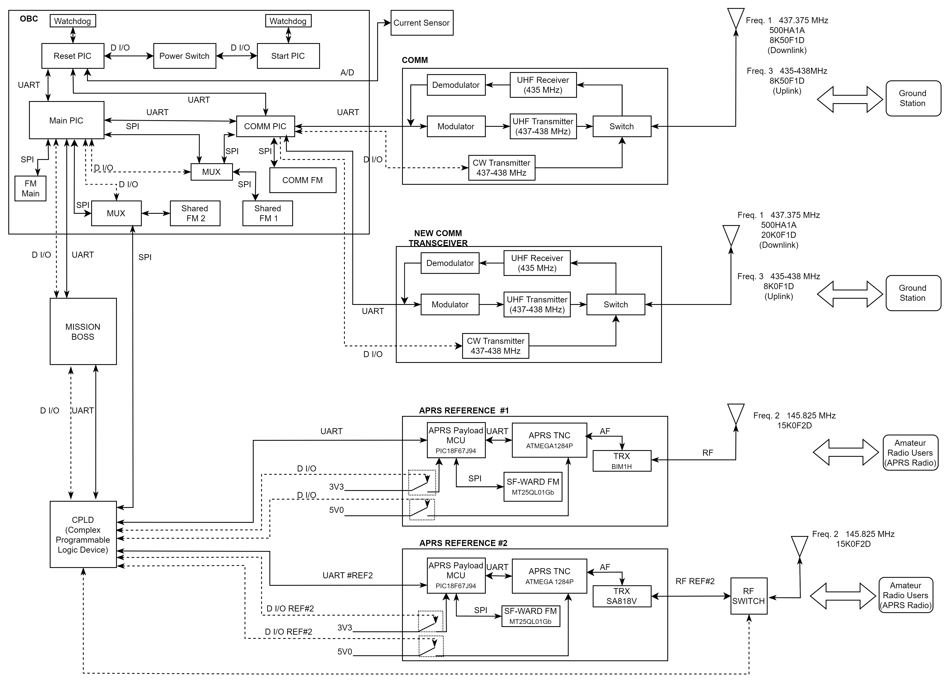
Block Diagram

Slide 5
Block Diagram

Slide 6
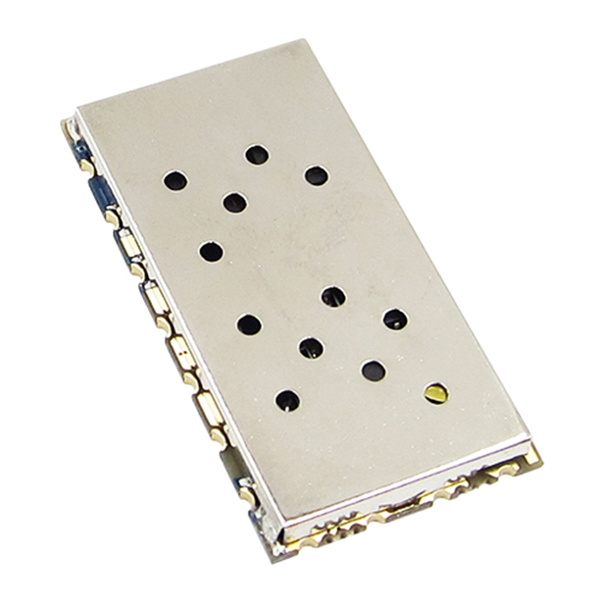
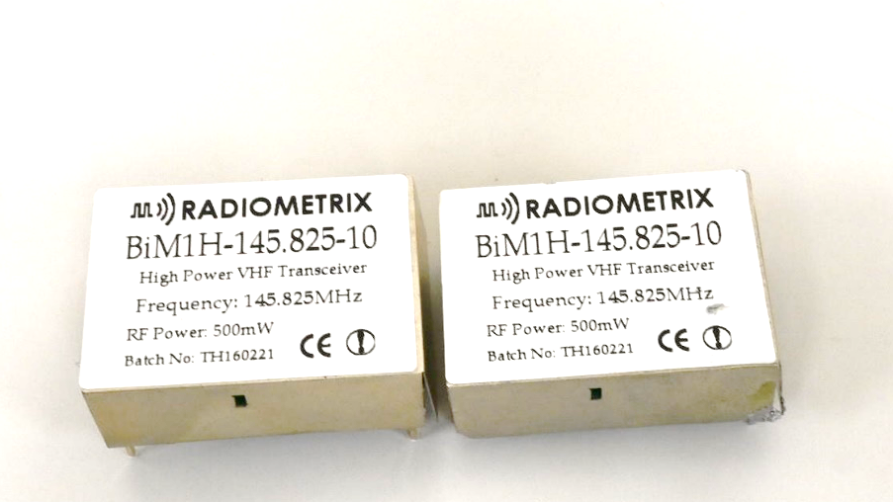
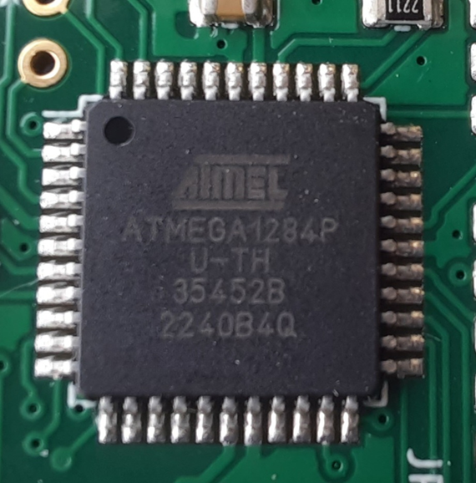
System Main Components
Transceivers:
Radiometrix BiM1H
(BIRDS Heritage)
Nice RF SA818V
(PSAT-2 satellite aka NO-104)
Terminal Node Controller
ATMEGA 1284P
(from Byonics TT4)

Slide 7
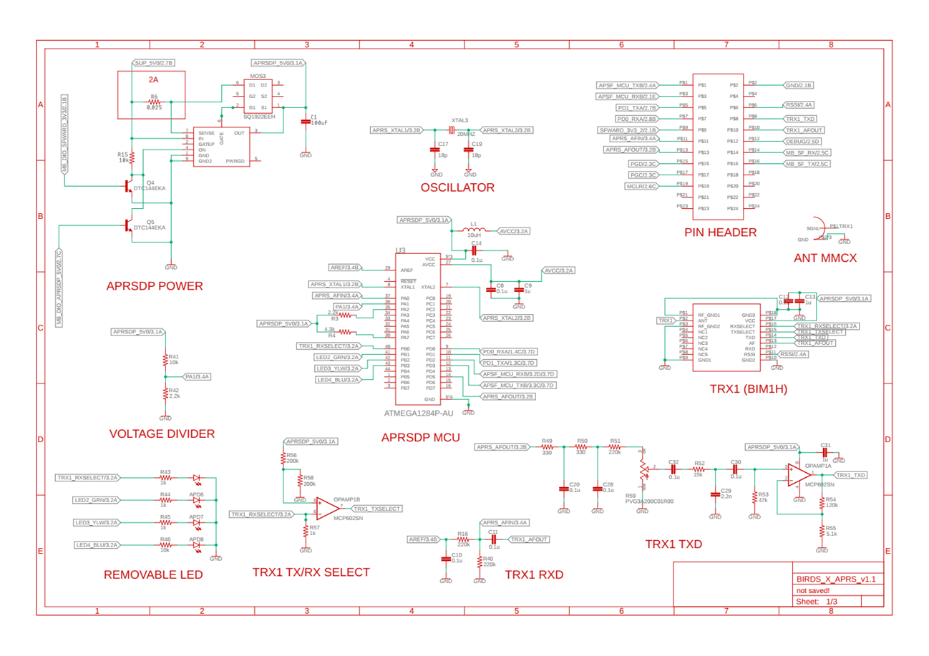
Schematics

Slide 8
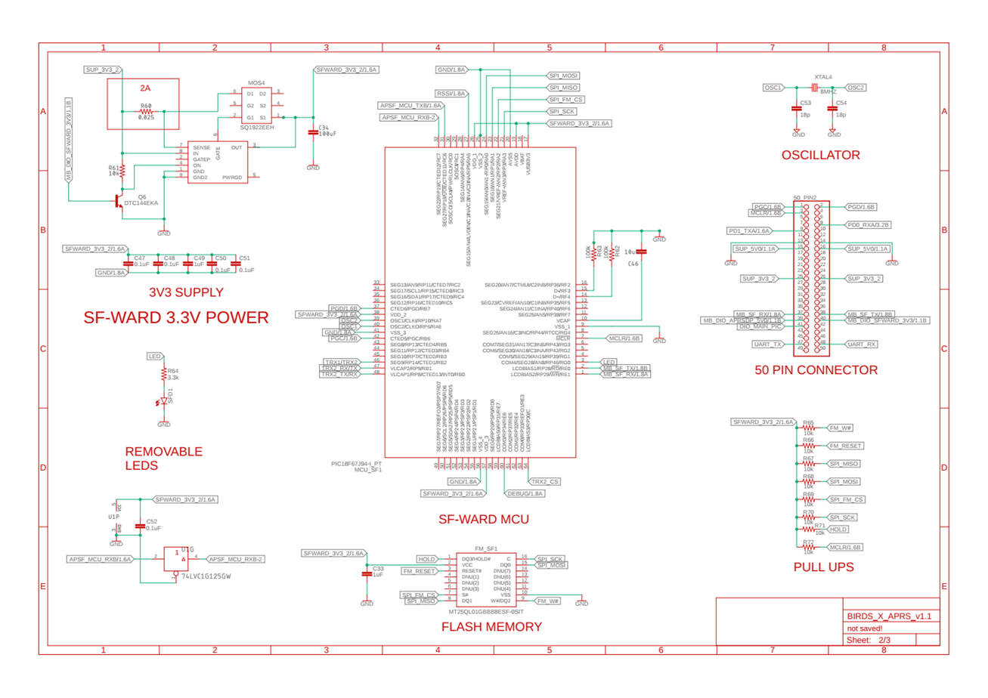
Schematics

Slide 9
PCB design

Slide 10
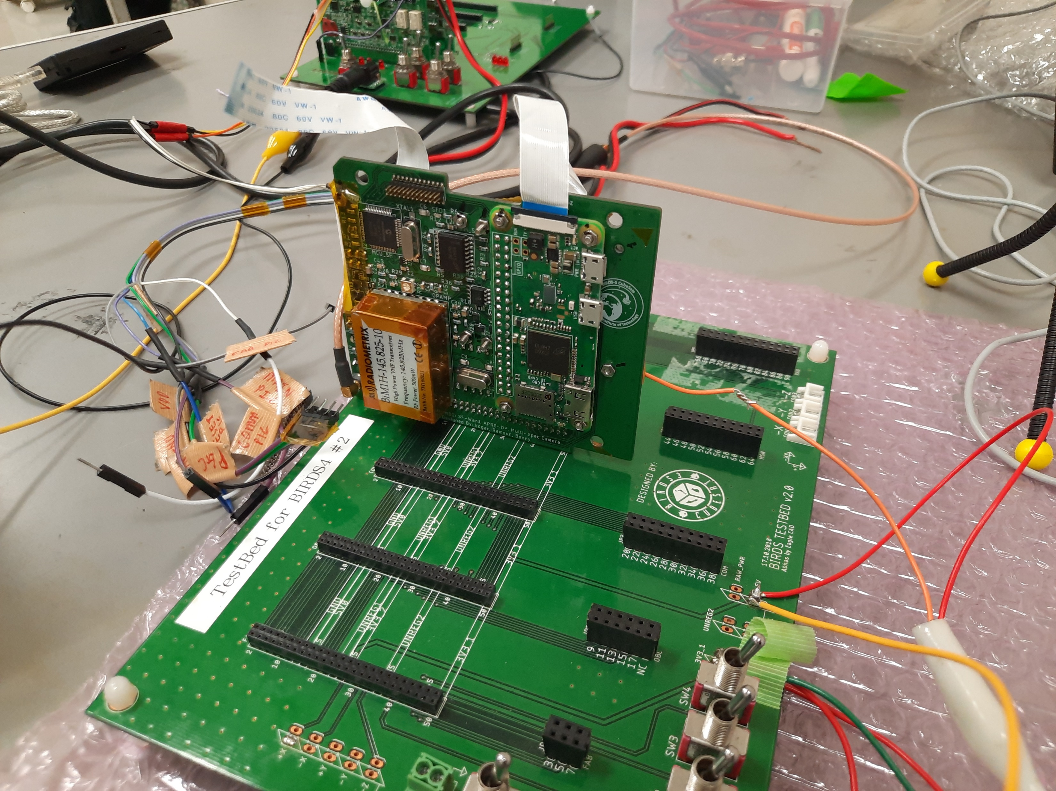
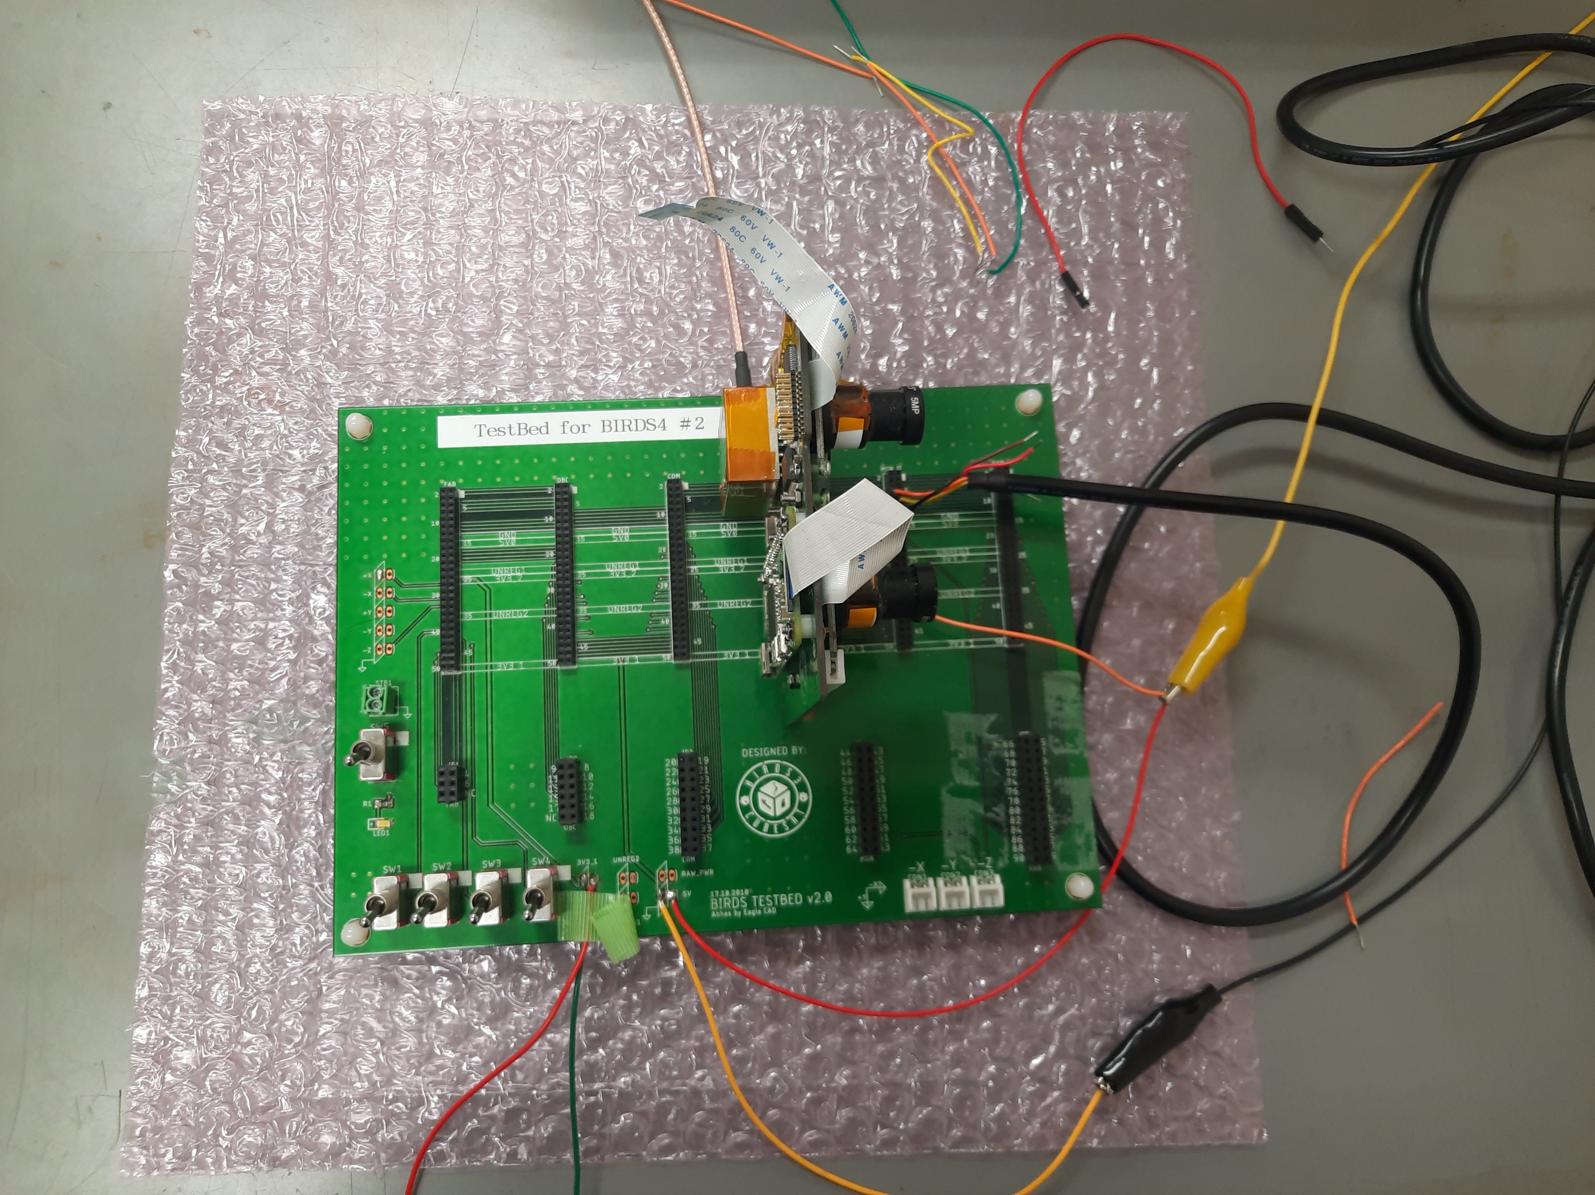
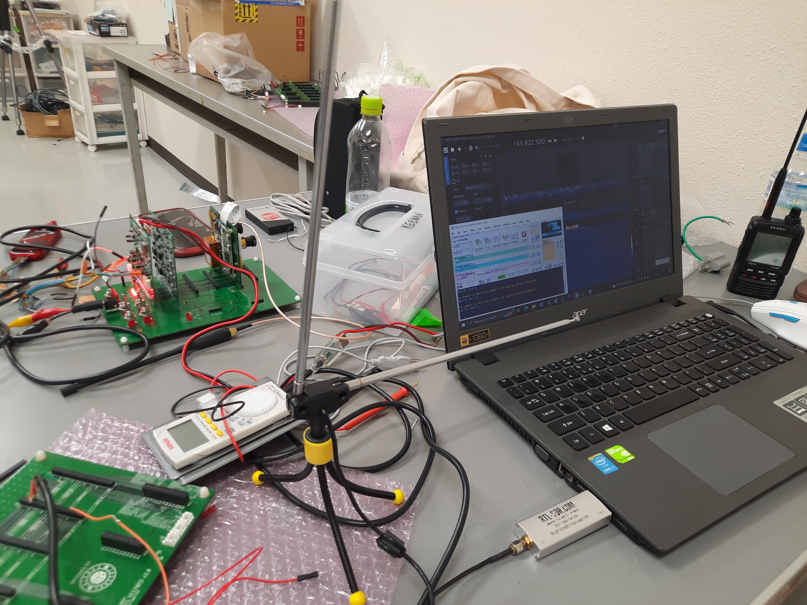
APRS-DP test setup
MCX to SMA Cable
BIRDS-3
FAB
+5V lines
UART to USB cable
Antenna
SDR+Computer
APRS capable radio
SDR + Computer

Slide 11
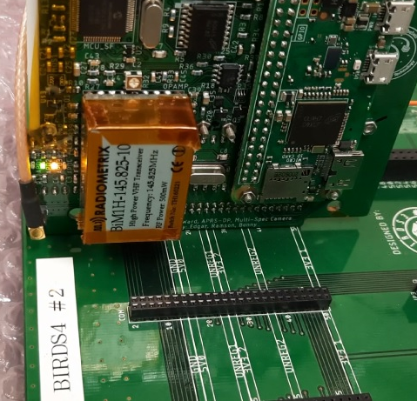
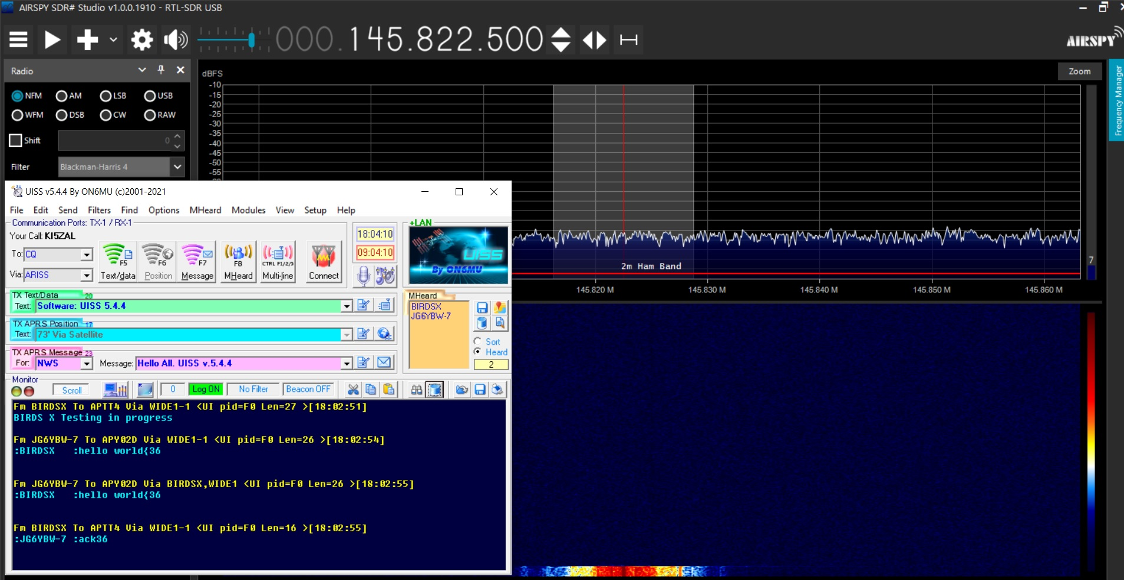
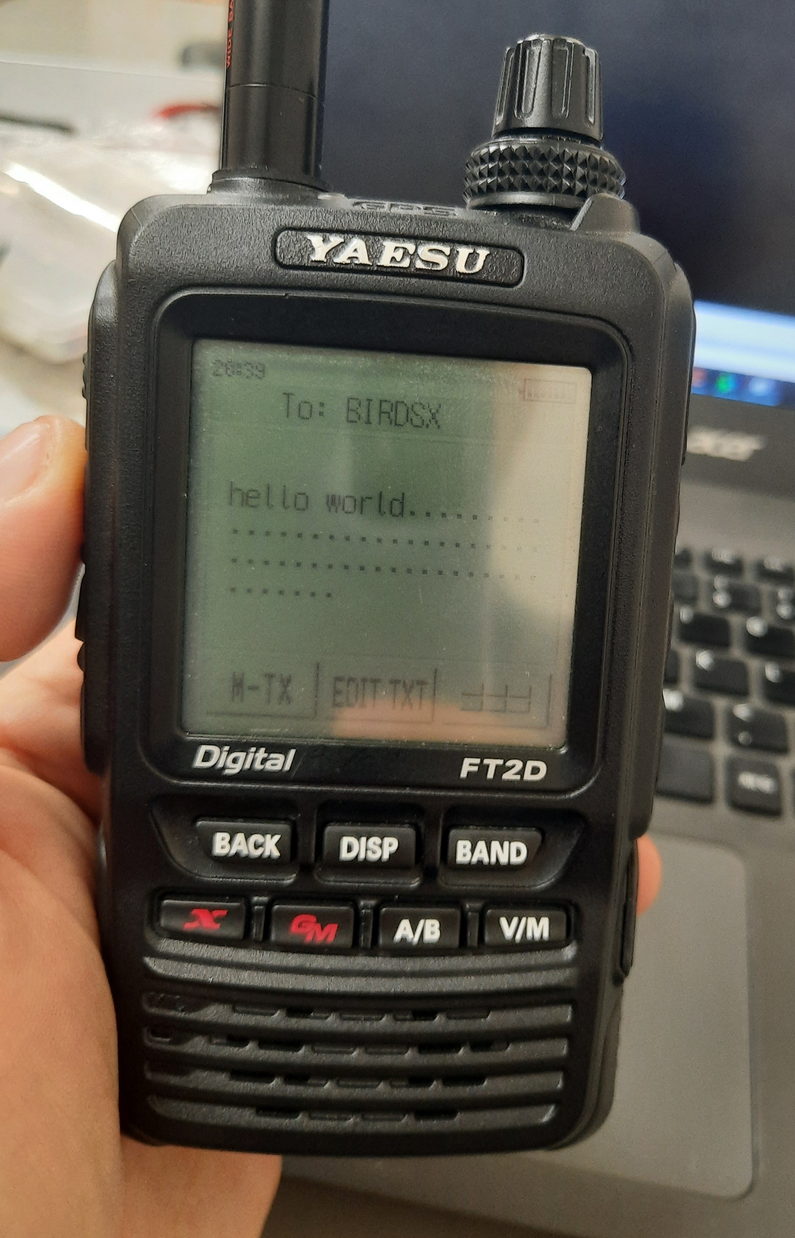
APRS-DP test results
BIRDS-3
FAB
MCX to SMA Cable
LED turn on
TNC Lights
Beacon from APRS board
APRS message from handheld radio
APRS message relay from APRS board
Confirmation message relay from APRS board to handheld radio

Slide 12
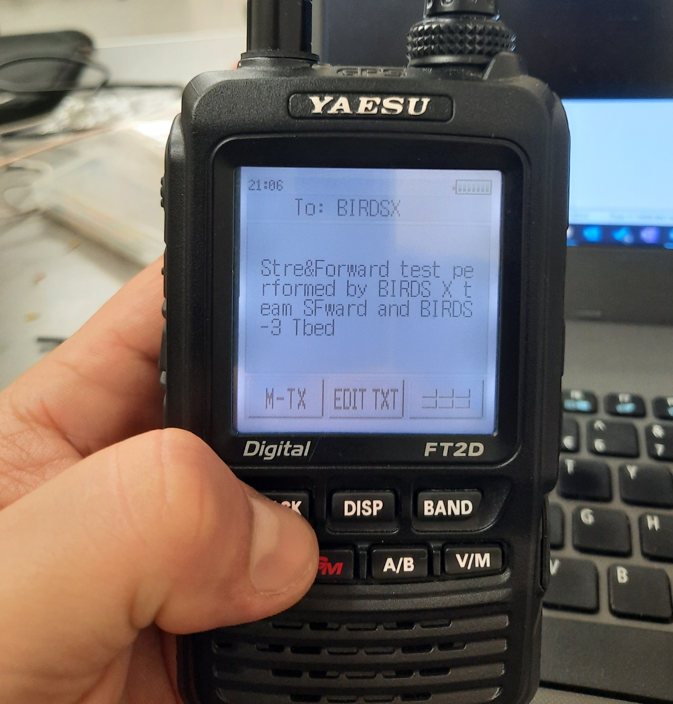
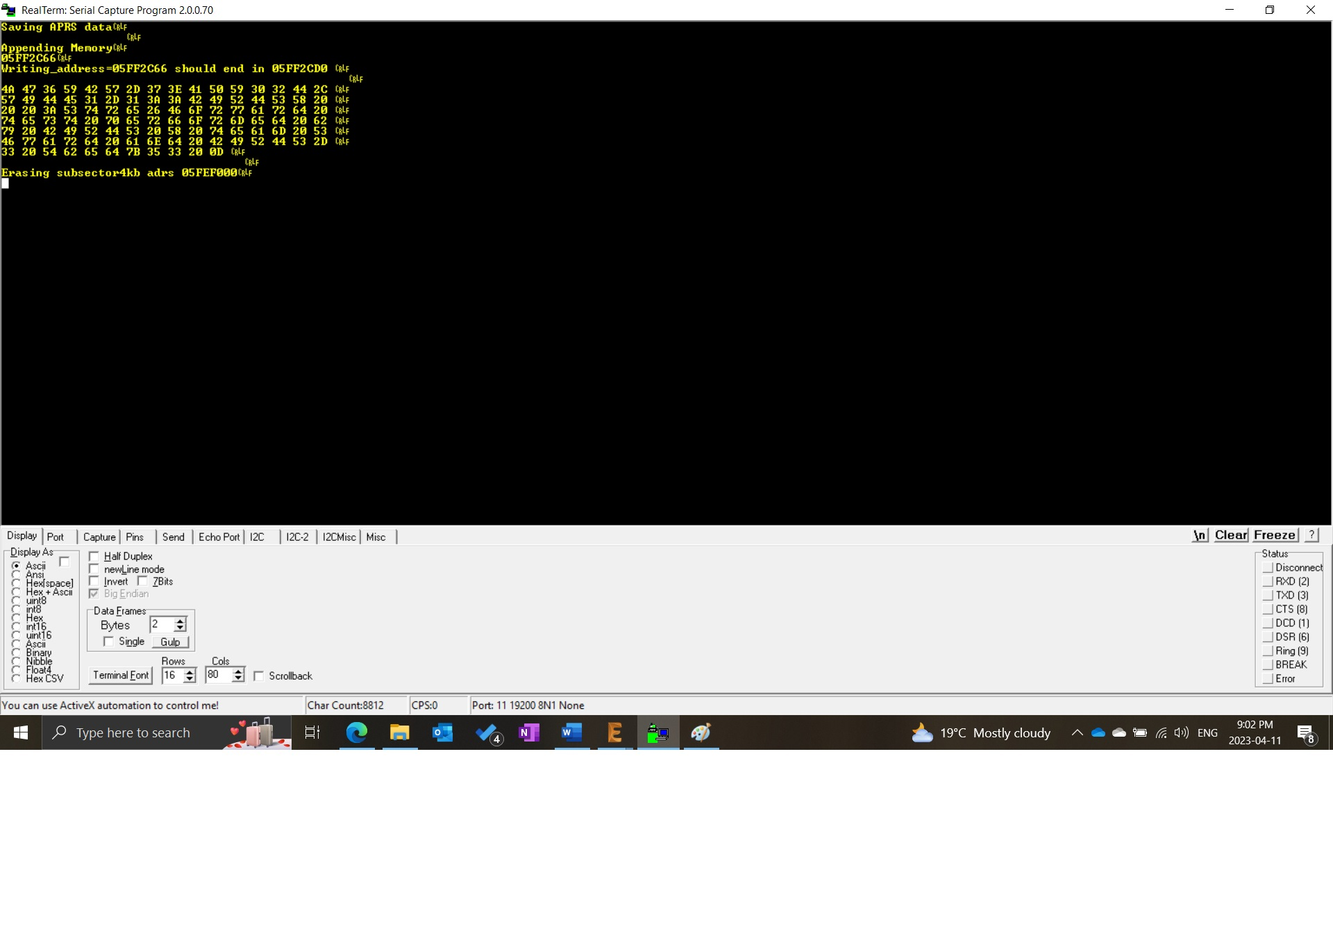
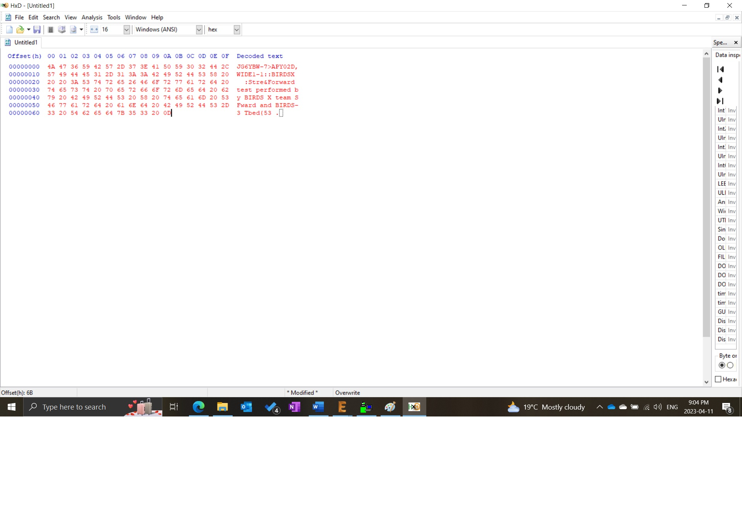
APRS tests results
BIRDS-3
FAB
MCX to SMA Cable
TNC Lights

Slide 13
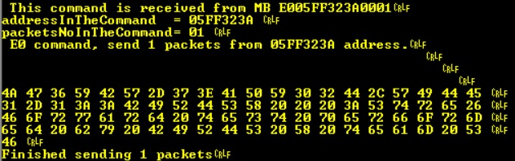
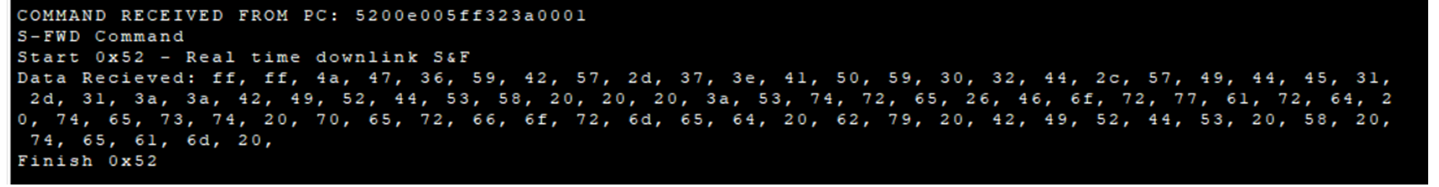
APRS tests results
BIRDS-3
FAB
MCX to SMA Cable
TNC Lights

Slide 14
RAS: APRS-R
SR1.1 - Payload shall be controllable through an uplink command from a control ground station
ID | Design Requirements | ID | Verification Requirements | Verification Method | Status
DR1.1.1 | Command will be sent from ground station using UHF uplink frrequency | VR1.1.1.1 | Measure receivable signal power of COMM transceiver | Using spectrum analyzer | Δ
DR1.1.2 | OBC will relay the command to Mission Boss to activate APRS Reference payload | VR1.1.2.1 | Check if the APRS/SF-WARD payload is activated/deactivated | Using terminal software to read APRS reference MCU | ○
Reference: | ○ | Successful / Verified
 | Δ | Partially successful / More tests required
 | × | Failed / Not tested yet

Slide 15
RAS: APRS-R
SR1.2 - VHF transceiver operating in half-duplex will receive data from amateur radio users/ground terminal
ID | Design Requirements | ID | Verification Requirements | Verification Method | Status
DR1.2.1 | Receiver will demodulate FM signal received | VR1.2.1.1 | Check AFSK output of receiver | Using spectrum analyzer | Δ
DR1.2.2 | TNC will decode received AFSK signal | VR1.2.2.1 | Check data output of TNC | Display serial output of TNC through serial monitor on PC | ○
DR1.2.3 | APRS reference payload will receive transmitted data and store it | VR1.2.3.1 | Check received data if it matches transmitted data through wired testing | Display received OBC data through serial on PC | ○
 |  | VR1.2.3.2 | Check stored data in flash memory | Read flash memory through APRS reference serial interface | ○
Reference: | ○ | Successful / Verified
 | Δ | Partially successful / More tests required
 | × | Failed / Not tested yet

Slide 16
RAS: APRS-R
SR1.3 - Payload shall store received packets (APRS message and ground sensor) into memory
ID | Design Requirements | ID | Verification Requirements | Verification Method | Status
DR1.3.1 | APRS reference MCU shall process received AX.25 frame into the correct fields | VR1.3.1.1 | Check processed data of APRS reference MCU | Display processed data through serial interfase | ○
DR1.3.2 | Flash memory of capacity of at least 32 MB | VR1.3.2.1 | Check specification and writable memory | Through write operations | Δ
Reference: | ○ | Successful / Verified
 | Δ | Partially successful / More tests required
 | × | Failed / Not tested yet

Slide 17
RAS: APRS-R
SR1.4 - Payload shall transmit stored data to ground station upon command from ground station using COM data downlink frequency
ID | Design Requirements | ID | Verification Requirements | Verification Method | Status
DR1.4.1 | COMM MCU shall read stored memory in APRS reference flash memory for downlink | VR1.4.1.1 | Check data transmitted by COMM | Display received data | Δ
Reference: | ○ | Successful / Verified
 | Δ | Partially successful / More tests required
 | × | Failed / Not tested yet

Slide 18
Schedule
 | TASK | 2022 |  |  |  |  | 2023
 |  | DEC |  |  |  |  | JANUARY |  |  |  |  | FEBRUARY |  |  |  | MARCH |  |  |  | APRIL |  |  |  | MAY |  |  |  |  | JUNE |  |  |  | JULY |  |  |  | AUGUST |  |  |  |  | SEPTEMBER |  |  |  | OCTOBER |  |  |  | NOVEMBER |  |  |  |  | DECEMBER
 |  | 48 | 49 | 50 | 51 | 52 | 1 | 2 | 3 | 4 | 5 | 6 | 7 | 8 | 9 | 10 | 11 | 12 | 13 | 14 | 15 | 16 | 17 | 18 | 19 | 20 | 21 | 22 | 23 | 24 | 25 | 26 | 27 | 28 | 29 | 30 | 31 | 32 | 33 | 34 | 35 | 36 | 37 | 38 | 39 | 40 | 41 | 42 | 43 | 44 | 45 | 46 | 47 | 48 | 49 | 50 | 51 | 52
 | Mission Definition Review (MDR)
 | Check legacy missions' info
 | Test BIRDS APRS legacy boards
 | Programming MCU
 | Preliminary Design Review (PDR)
 | EM board development
 | EM components procurement
 | EM board testing
 | Integration with other subsystems
 | Critical Design Review (CDR)
 | EM Board space environment testing
 | FM Board development
 | FM Integration
 | Testing
BIRDS-3
FAB
MCX to SMA Cable
TNC Lights

